Slide 1




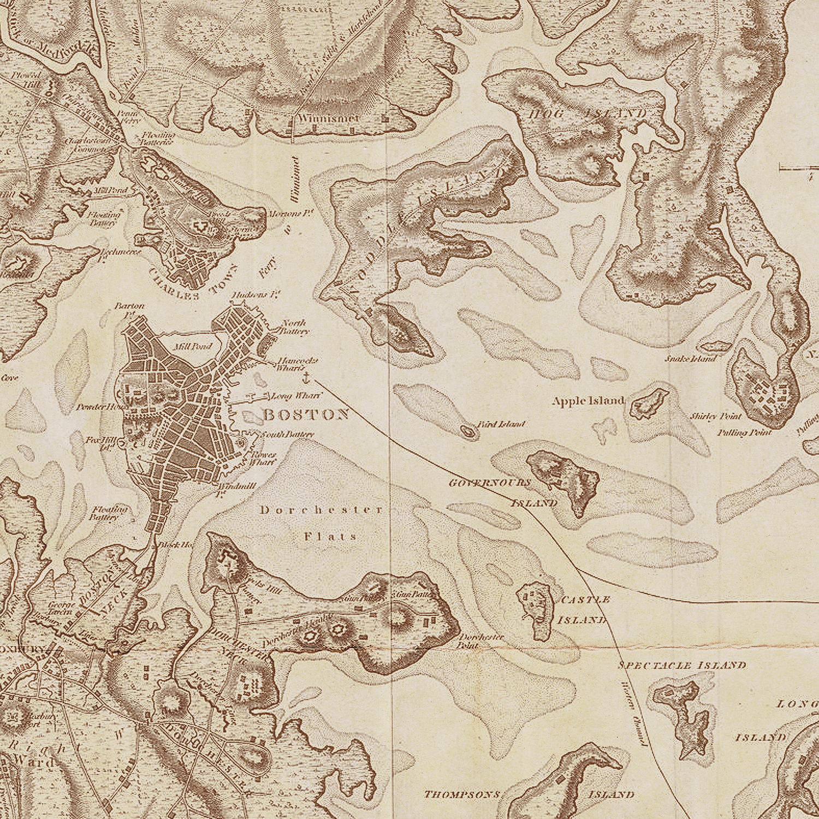

TITLE
Interactive portfolio project using Html, CSS & JavaScript
😊Student Name: Shalini R
😊Register No and
NMID: astvu35624U09041.
😊Department: BCA 2nd year
😊Collage: Government Arts and science College
/Thiruvallur University

Slide 2


Agenda
1.Problem Statement.
2.Project Overview.
3.End Users.
4.Tools & Technologies.
5.Portfolio Design & Layout. 6.Features & Functionality
7. Result & Screenshot.
8.Conclusion.
9.Github Link.

Slide 3

Problem statement
Students often lack interactive portfolios.
Traditional resumes are static & less engaging.
Need: A digital, interactive platform to showcase skills.

Slide 4

Project Overview
1. Title – Student Attendance System.
2. Objective – To simplify and digitalize attendance tracking.
3. Scope / Features – Record attendance, generate reports, notify absentees.
4. Outcome – Saves time, reduces errors, and improves accuracy.

Slide 5
End user
People who directly use the system.
They depend on it to meet their needs.
Their feedback improves the project.
Examples: students, customers, farmers, etc.

Slide 6
Tools & Techniques
HTML, CSS, JavaScript
Responsive Design
Google Fonts & Animations

Slide 7

Portfolio Design & Layout
Portfolio Design & Layout
Modern card-based layout
Clean UI with shadows & rounded corners
Back-to-top button (smooth UX)
Responsive, mobile-friendly design

Slide 8
Features & Functionality
Features & Functionality
Interactive sections (skills, education, etc.)
Back-to-top button
Year auto-update in footer
Simple, professional design

Slide 9
Results & screen shot
Successfully created a personal interactive portfolio
Show screenshots of the webpage here

Slide 10
Conclusion
Portfolio is a digital resume + project showcase
Demonstrates knowledge in web development
Can be expanded with projects, interactivity, and multimedia

Slide 11


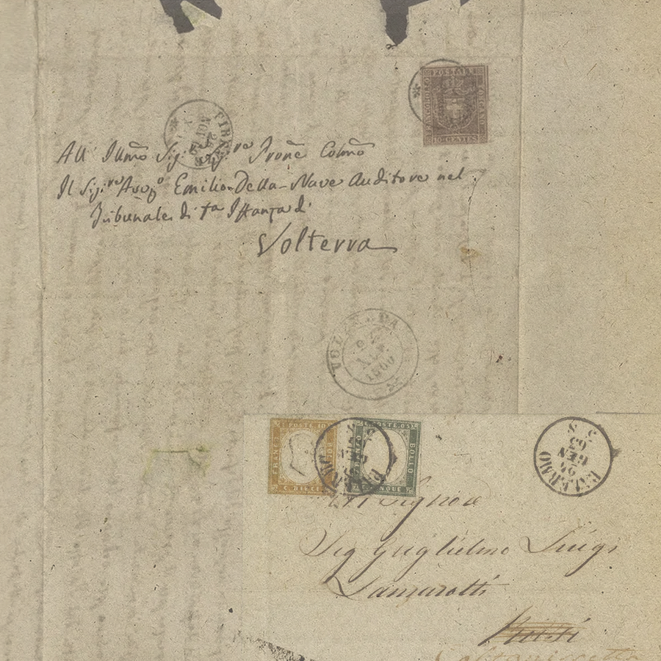
Thank
You

